Slide 1
Integrative Functions of the Brain

Slide 2
higher brain functions
Sleep
Memory
Cognition
Emotion
Sensation
Motor control
Language.

Slide 3
The Electroencephalogram
EEG
For research and clinical purposes, it is common to monitor electrical activity called brain waves. Recorded with electrodes on the scalp, these are rhythmic voltage changes resulting predominantly from synchronized postsynaptic potentials (not action potentials) in the superficial layers of the cerebral cortex. The recording, called an electroencephalogram (EEG), is useful in studying normal brain functions such as sleep and consciousness, and in diagnosing degenerative brain diseases, metabolic abnormalities, brain tumors, trauma, and so forth.

Slide 4
The Electroencephalogram
EEG

Slide 5
Brain waves
Alpha(α)waves have a frequency of 8 to13 Hz and are recorded especially in the parieto-occipital area. They dominate the EEG when a person is awake and resting, with the eyes closed and the mind wandering. They are suppressed when a person opens the eyes, receives specific sensory stimulation, or engages in a mental task such as performing mathematical calculations. They are absent during deep sleep.
Beta (β) waves have a frequency of 14 to 30 Hz and occur in the frontal to parietal region. They are accentuated during mental activity and sensory stimulation.

Slide 6
Brain waves
Theta (θ) waves have a frequency of 4 to 7 Hz. They are normal in children and in drowsy or sleeping adults, but a predominance of theta waves in awake adults suggests emotional stress or brain disorders.
Delta (δ) waves are high-amplitude “slow waves” with a frequency of less than 3.5 Hz. Infants exhibit delta waves when awake, and adults exhibit them in deep sleep. A predominance of delta waves in awake adults indicates serious brain damage.

Slide 7
Sleep
Sleep can be defined as a temporary state of unconsciousness from which (in contrast to coma) one can awaken when stimulated. It is one of many bodily functions that occur in cycles called circadian rhythms, so named because they are marked by events that reoccur at intervals of about 24 hours.
Sleep occurs in distinct stages recognizable from changes in the EEG. In the first 30 to 45 minutes, the EEG waves drop in frequency but increase in amplitude as one passes through four sleep stages

Slide 8
Sleep
Stage 1. One feels drowsy, closes the eyes, and begins to relax. Thoughts come and go, often accompanied by a drifting sensation. One awakens easily if stimulated. The EEG is dominated by alpha waves.
Stage 2. One passes into light sleep. The EEG declines
in frequency but increases in amplitude. Occasionally
it exhibits 1 or 2 seconds of sleep spindles, high spikes resulting from interactions between neurons of the thalamus and cerebral cortex.

Slide 9
Sleep
Stage 3. This is moderate to deep sleep, typically beginning about 20 minutes after stage 1. Sleep spindles occur less often, and theta and delta waves appear. The muscles relax, and the vital signs (body temperature, blood pressure, and heart and respiratory rates) fall.
Stage 4. This is also called slow-wave sleep (SWS), because the EEG is dominated by low-frequency, high-amplitude delta waves. The muscles are now very relaxed, vital signs are at their lowest levels, and one becomes difficult to awaken.

Slide 10
Sleep
About five times a night, a sleeper backtracks from stage 3 or 4 to stage 2 and exhibits bouts of rapid eye movement (REM) sleep. This is so named because the eyes oscillate back and forth as if watching a movie. It is also called paradoxical sleep because the EEG resembles the waking state, yet the sleeper is harder to arouse than in any other stage. The vital signs increase and the brain consumes even more oxygen than when awake. Sleep paralysis, other than in the muscles of eye movement, is especially strong during REM sleep. Sleep paralysis usually prevents the sleeper from acting out his or her dreams.

Slide 11
Sleep Stages and Brain Activity.

Slide 12
Cognition
the range of mental processes by which we acquire and use knowledge-sensory perception, thought, reasoning, judgment, memory, imagination, and intuition. Such functions are widely distributed over regions of cerebral cortex called association areas, which constitute about 75% of all brain tissue. This is the most difficult area of brain research and the most incompletely understood aspect of cerebral function.

Slide 13
Memory
The hippocampus of the limbic system is an important memory-forming center. It does not store memories, but organizes sensory and cognitive experiences into a unified long-term memory. The hippocampus learns from sensory input while an experience is happening, but it has a short memory. Later, perhaps when one is sleeping, it plays this memory repeatedly to the cerebral cortex, which is a “slow learner” but forms longer-lasting memories. This process of “teaching the cerebral cortex” until a long-term memory is established is called memory consolidation. Long-term memories are held in various areas of cortex. One’s vocabulary and memory of faces and familiar objects, for example, reside in the superior temporal lobe, and memories of one’s plans and social roles are in the prefrontal cortex.

Slide 14
Emotion
Emotional feelings and memories are not exclusively cerebral functions, but result from an interaction between areas of the prefrontal cortex and diencephalon.
But the feelings themselves, and emotional memories, arise from deeper regions of the brain, especially the hypothalamus and amygdala. Here lie the nuclei that stimulate us to recoil in fear from a rattlesnake or yearn for a lost love.
The amygdala is a major component of the limbic system described earlier. It receives processed information from the general senses and from vision, hearing, taste, and smell.

Slide 15
Sensation
The Special Senses are limited to the head, and some employee relatively complex sense organs. They are vision, hearing, equilibrium, taste, and smell.
The General Senses are distributed over the entire body and employ relatively simple receptors. They include such senses as touch, pressure, stretch, movement, heat, cold, and pain.

Slide 16
The Special Senses
Vision. Visual signals are received by the primary visual cortex in the far posterior region of the occipital lobe. This is bordered anteriorly by the visual association area, which includes all the remainder of the occipital lobe, some of the posterior parietal lobe (concerned with spatial perception), and much of the inferior temporal lobe, where we recognize faces and other familiar objects.
Hearing. Auditory signals are received by the primary auditory cortex in the superior region of the temporal lobe and in the nearby insula. The auditory association area occupies areas of temporal lobe inferior to the primary auditory cortex and deep within the lateral sulcus. This is where we become capable of recognizing spoken words, a familiar piece of music, or a voice on the telephone.

Slide 17
The Special Senses
Equilibrium. Signals from the inner ear for equilibrium project mainly to the cerebellum and several brainstem nuclei concerned with head and eye movements and visceral functions. Some fibers of this system, however, are routed through the thalamus to areas of association cortex in the roof of the lateral sulcus and near the lower end of the central sulcus. This is the seat of consciousness of our body movements and orientation in space.
Taste and smell. Gustatory (taste) signals are received by the primary gustatory cortex in the inferior end of the postcentral gyrus of the parietal lobe (discussed shortly) and an anterior region of the insula. Olfactory (smell) signals are received by the primary olfactory cortex in the medial surface of the temporal lobe and inferior surface of the frontal lobe. The orbitofrontal cortex mentioned earlier serves as a multimodal association area for both taste and smell, and is thus highly important in our enjoyment or rejection of various foods and drinks.

Slide 18
The General Senses

Slide 19
Motor Control
The Primary Motor Cortex (Precentral Gyrus).

Slide 20
Motor Control
Motor Pathways Involving the Cerebellum. .

Slide 21
Language
Language includes several abilities - reading, writing, speaking, sign language, and understanding words - assigned to different regions of cerebral cortex

Slide 22
Language
The Wernicke area is responsible for the recognition of spoken and written language. It lies just posterior to the lateral sulcus, usually in the left hemisphere, at the crossroad between visual, auditory, and somatosensory areas of cortex, receiving input from all these neighboring regions.
The Broca area, located in the inferior prefrontal cortex of the same hemisphere. PET scans show a rise in the metabolic activity of the Broca area as one prepares to speak or sign. This area generates a motor program for the muscles of the larynx, tongue, cheeks, and lips to produce speech, as well as for the hand motions of signing. It transmits this program to the primary motor cortex, which executes it-that is, it issues commands to the lower motor neurons that supply the relevant muscles.

Slide 23
Language
Language Centers of the Left Hemisphere.

Slide 24
Language
Aphasia is any language deficit resulting from lesions in the hemisphere (usually the left) containing the Wernicke and Broca areas.
Nonfluent (Broca) aphasia
Fluent (Wernicke) aphasia

Slide 25
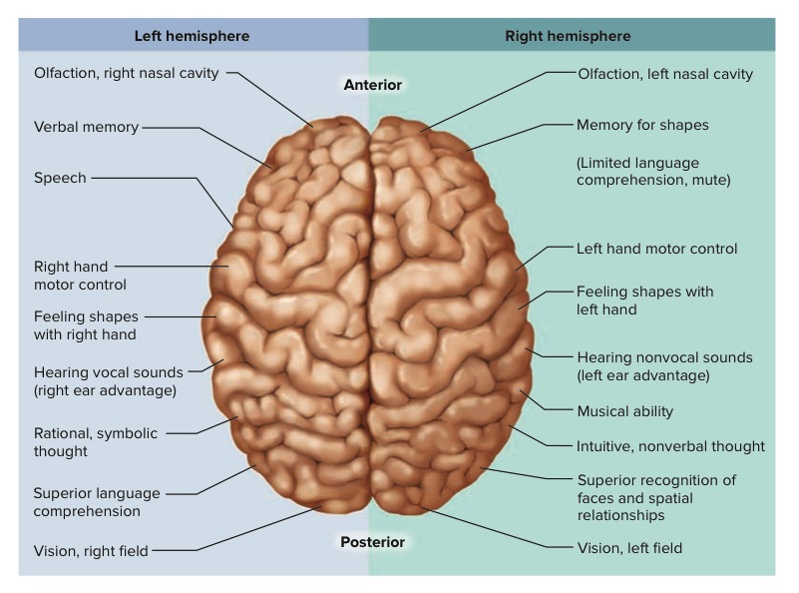
Cerebral Lateralization

Slide 26
Thank You!

